Slide 1
Standard 1
PURPOSE
The Automobile Technician Training Program should have clearly stated program goals, related to the needs of the students and employers served

Slide 2
Standard 1.1
Employment Potential
  54 dealerships in the East Valley and 110 total in the Greater Phoenix area, 90 plus local independent garages, and 80 parts stores within the East Valley.
  Based on the Department of Labor, Automotive Service technicians have a projected 9-18% growth rate (between 2013 and 2025) for the state of Arizona.
  http://www.labor.ny.gov/stats/lsproj.shtm
  http://www.bls.gov/ooh/installation-maintenance-and-repair/automotive-service-technicians-and-mechanics.htm

Slide 3
Standard 1.1
Employment Potential
Dealerships
  Chapman Ford
  Airpark Chrysler Jeep
  Audi of Chandler
  Acura of Tempe
  Belle Ford
  Berge Mazda VW
  Big 2 Mitsubishi and Big 2 Toyota
  Brown and Brown Chevrolet
  Camelback Toyota
  Cardinal Way Mazda
  Chapman Chevrolet
  Coulter Cadillac of Tempe
  Colltesy Chevrolet
  Tempe KIA
  Thorobred Chevrolet
  Van Chevrolet
  Nissan of Scottsdale
  Pinnacle Nissan
  Power Nissan Chandler
  Power Toyota and Power Scottsdale
  Riverview Nissan and Toyota
Coury Buick GMC
Earnhardt Dodge, Ford, Mazda, Nissan, and Toyota
Fiesta Lincoln Mercury
Freeway Chevrolet
Honda of Superstition Springs
Home Hyundai
Home Kia
Infinity of Scottsdale
Kachina Cadillac Hummer
Mazda of Tempe
Power Chevrolet, Ford, Nissan
Mercedes of Chandler
Robert Home Ford
San Tan Ford, Honda, Hyundai
Subaru Super Store
Superstition Springs Chrysler Jeep
Superstition Springs Infinity
Superstition Springs Lexus
Superstition Springs Toyota
Tempe Dodge Chrysler
H-Brown Pontiac Buick GMC

Slide 4
Standard 1.1
Independence Shops/Retail
Employment Potential
  Car Quest – 7 locations
  Aamco Transmission – 10 locations
  Quality Transmission
  Thompson Auto Repair
  Sears – 4 locations
  Meineke – 9 locations
  NAPA – 10 locations
  Purcell's Tires
  Greulichs
  Pep Boys – 6 locations
  AutoZone – 21 locations
  Parts Authority – 3 locations
  Independent automotive shops – too many to count

Slide 5
Standard 1.2
Program Description/Goals
  Admission/Registration Information - http://www.mesacc.edu/admissions-records/become-student-mcc
  Areas of Specialty Training - http://www.mesacc.edu/programs/
  Tuition and Fees - http://www.mesacc.edu/cashier-services/tuition-rates
  Faculty Qualifications - http://www.mesacc.edu/departments/applied-sciences-and-technology/faculty-staff
  Program Goals - http://www.mesacc.edu/programs/automotive-performance
  College Mission and Purpose - http://www.mesacc.edu/about/vision-mission-values

Slide 6
Standard 2
ADMINISTRATION
Program Administration should ensure that all instructional activities support and promote the goals of the program.

Slide 7
Standard 2.1
Student Competency Certification
  Transcript: All students attending classes at Mesa Community College have the option to receive or have a transcript sent to any prospective employer or future school. An official transcript contains the complete student course history including all classes attempted, grade awarded for all classes, credits accepted from other colleges, and the student’s grade point average for classes in the student’s major area of study and total accumulated grade point average. These are available upon request at the Office of Admissions and Records.
  Transcripts Requests:
  http://www.mesacc.edu/admissions-records/request-transcripts

Slide 8
Standard 2.1
Available Associate Degrees and Certificates
Degree / Certificate | Title | Courses
Associate in Applied Science (AAS) | Automotive Performance Technology | Course Sequence
Associate in Applied Science (AAS) | Caterpillar Technician Training | Course List
Certificate of Completion (CCL) | Automotive Electrical Systems | Course Sequence
Certificate of Completion (CCL) | Brakes, Alignment, Suspension and Steering | Course Sequence
Certificate of Completion (CCL) | Engine Performance and Diagnosis | Course Sequence

Slide 9
Standard 2.2
Chain of Command
  http://www.mesacc.edu/about/administration/organizational-charts

Slide 10
Standard 2.3
Administrative Support
  Program Review-See Exhibit 2.3A
  Training support is available in two forms: New Faculty Experience and EDU250
  http://www.mesacc.edu/sites/default/files/pages/section/students/service-learning/faculty_manual.pdf
  http://www.mesacc.edu/schedule/search
  Curriculum http://www.mesacc.edu/programs/automotive-performance
  Professional Growth Guidelines
  http://ctl.mesacc.edu/handbook/faculty-policies-and-practices/residential-faculty-policy-and-resources/

Slide 11
Standard 2.4
Written Policies
  Policies regarding safety, liability, and lab/shop operation should be written and prominently displayed as well as provided to all students and instructors. See next page or See Exhibit 2.4A
  Student Rights & Responsibilities
  http://www.mesacc.edu/students/student-rights-responsibilities
  The Maricopa Governance Policies, Standards and Guidelines
  http://ctl.mesacc.edu/handbook/employment-policies-and-resources/the-maricopa-governance-policies-standards-and-guidelines/
  Occupational Health and Safety
  https://www.mesacc.edu/employees/occupational-health-safety
  Student Handbook
  http://www.mesacc.edu/sites/default/files/pages/section/students/publications/mcc-student-handbook-2012-2013.pdf

Slide 12
Standard 2.4
Procedures:
1. All vehicles must have a filled out repair order
• Multi copy for paying customers
• Single copy for automotive students
• Print off labor times from Mitchell on Demand
• Enter tech number or names and class
• Describe what work was performed
2. Do not use impact guns for running down lug nuts on wheels
3. Do not close Mitchell on Demand on lab computers
4. Save all estimates before printing
5. If you need to access the internet for personal use, please use the computer lab in room TC 416
6. No parking in compound/back area unless given permission by instructor
7. No oil changes unless it’s to facilitate other maintenance
8. When using clicker style torque wrench, always unload the torque wrench before putting it away
9. Wipe down all tool before you return them
10. Always clean up your work area when finished
11. All vehicle must fit within the scope of the class to be worked on
12. Roll down the front windows before driving the vehicle into the shop
13. Keys remain in the vehicle when parked in the shop with windows down
Written Policies (Shop Safety)
  Safety:
  1. Anyone in the lab area MUST wear eye protection
  2. All footwear must be closed toe and constructed of safety material with non-skid soles
  3. All pants must have full length legs, shorts below knee is acceptable while working in the lab
  4. All spills must be cleaned up as soon as possible to avoid a slip or falling situation
  5. When working with brakes, half face inhalation masks are recommended
  6. Whenever a vehicle is required to be run in the shop, the floor ventilation system must be on
  7. Whenever you use any automotive chemicals, utilize the proper P.P.E. (personal protection equipment)
  8. Never operate a vehicle lift with someone under the vehicle on it.
  9. Report all injuries, no matter how minor to proper authorities
  See Exhibit 2.4A

Slide 13
Standard 2.5
Customer Vehicle Work
  Repair orders are in a three copy form, one for customer, one for program director, and the other for cashiers office to process payment. See Exhibit 2.5A
  The MCC Automotive Technology Program needs vehicles to inspect and service this semester. Our students complete repair assignments as part of their program of study. Your support of the Automotive Program enhances the students’ education by servicing your vehicle. Only vehicles from the 1996 model year and newer are eligible for this opportunity; vehicles need to be equipped with the latest technology to benefit students. The types of inspections and repairs are limited to the current semester’s subjects. See Exhibit 2.5B
  There are no charges for vehicle inspections and repair estimates. Customers will receive a labor estimate and an itemized list of the recommended parts to complete the repair. If repairs are recommended, the customer must acquire all parts prior to the start of any repair. Suggested sources for professional quality parts will be included with the repair estimate. After the initial inspection and recommendations for parts and labor are provided to the customer, a second appointment will need to be made for the actual repair. Actual completion times required for repairs cannot be provided. Industry established labor time guides are used to determine labor costs for repairs. Rate is $25.00 per flat rate labor hour. See Exhibit 2.5B
  All Payments are process through the campus cashiers office into the auto education account fund 230 See Exhibit 2.5C

Slide 14
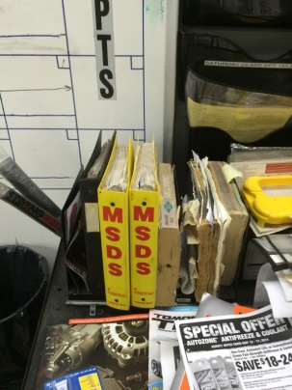
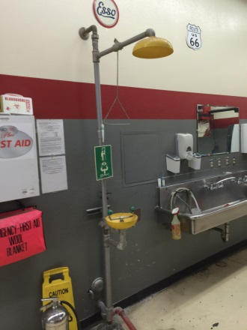
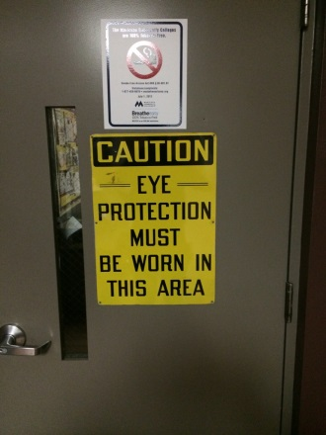
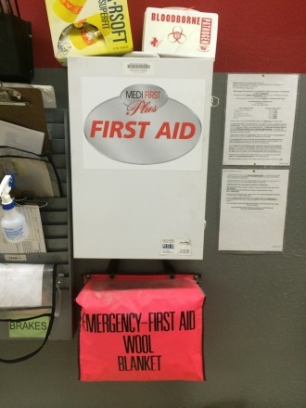
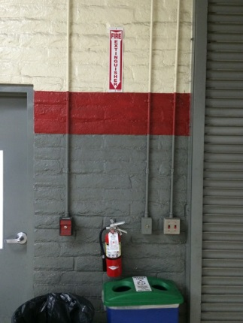
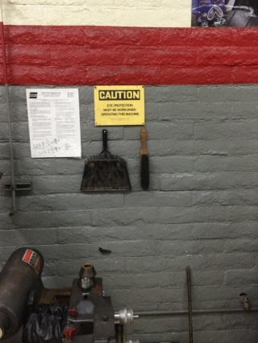
Standard 2.6
Legal Requirements
  MSDS sheets located on South Wall next to TC 227
  Hazmat Policies and Procedures
  http://www.mesacc.edu/employees/occupational-health-safety/training-programs/hazardous-materials
  MCC Automotive Department Safety

Slide 15
Standard 2.7
First Aid
  Render First Aid
  http://www.mesacc.edu/employees/occupational-health-safety/emergency-procedures/render-first-aid

Slide 16
Standard 3
LEARNING RESOURCES
Support material consistent with both program goals and performance objectives should be available to staff and students.

Slide 17
Standard 3.1
Service Information
  Students have access to Mitchell on Demand and ALLDATA for current manufactures service procedures.
  http://www.prodemand.com/
  http://www.alldata.com/
  Access is available on 8 computers in the lab area, TC 50 computer lab TC416, or anywhere on MCC campus computers such as the library.

Slide 18
Standard 3.2
Multimedia
  MCC Automotive classrooms media
  Computers with Microsoft Word for PPT
  Projectors
  DVD/VCR
  Document Cameras
  Centralized Printer in lab for student and Instructor
  Color printer for Instructors only.

Slide 19
Standard 3.3
Periodicals
  Local Mesa Community College Paper
  Automotive Mag
  Undercar Digest
  Transmission Digest
  Honda Tuning
  Import Car
  Techshop
  Truckin
  Super Street
  Road & Track
  Motor Trend
  Motor Age
  Tomorrow’s Technicians

Slide 20
Standard 3.4
Student Resources
Books
  Electrical
  https://aztransmac2.asu.edu/cgi-bin/WebObjects/acres.woa/wa/freeForm2?id=48855
  Brakes
  https://aztransmac2.asu.edu/cgi-bin/WebObjects/acres.woa/wa/freeForm2?id=48854
  Air Conditioning
  https://aztransmac2.asu.edu/cgi-bin/WebObjects/acres.woa/wa/freeForm2?id=48856
  Engine Performance
  https://aztransmac2.asu.edu/cgi-bin/WebObjects/acres.woa/wa/freeForm2?id=48857
  Power Trains
  https://aztransmac2.asu.edu/cgi-bin/WebObjects/acres.woa/wa/freeForm2?id=48845
  Auto Service Operations
  https://aztransmac2.asu.edu/cgi-bin/WebObjects/acres.woa/wa/freeForm2?id=48845
  Steering & Suspension
  https://aztransmac2.asu.edu/cgi-bin/WebObjects/acres.woa/wa/freeForm2?id=48853
  Engine Theory
  https://aztransmac2.asu.edu/cgi-bin/WebObjects/acres.woa/wa/freeForm2?id=48846
  Electrical-Automotive Electricity Etc 5th Edition Author: Hollembeak Publisher: Cengage Learning ISBN: 9781435470101
  Brakes-Automotive Technology 4th Edition Author: Halderman Publisher: Prentice Hall PTR ISBN: 9780132804745
  Air Cond-Today's Technician: Automotive Heating & Air Cond5th Edition Author: Schnubel Publisher: Cengage Learning ISBN: 9781133017455
  Engine Perf-Automotive Engine Performance Author: Pickerill Publisher: Cengage Learning ISBN: 9781133592891
  Power Trains-Today's Technician: Automotive 5th Edition Author: Schnubel Publisher: Cengage Learning ISBN: 9781133017455
  Auto Service Operations-Handouts (no book required)
  Steering & Susp-Automotive Technology 4th Edition Author: Halderman Publisher: Prentice Hall PTR ISBN: 9780132804745
  Engine Theory-Automotive Technology 4th Edition Author: Halderman Publisher: Prentice Hall PTR ISBN: 9780132804745

Slide 21
Standard 4
FINANCES
Funding should be provided to meet the program goals and performance objectives.

Slide 22
Standard 4.1
Program Training Cost
  Mesa Community College charges $87.00 per credit for any classes taken
  http://www.mesacc.edu/cashier-services/tuition-rates
  http://www.mesacc.edu/financial-aid/who-eligible/cost-attendance

Slide 23
Standard 4.1
Budget
  The Auto Budget Balances has four sheets in excel
  See Exhibit 4.2A
  Fund 1, Each year is started with $7200.00 for General Supplies, Account 54100.
  See Exhibit 4.2A
  Fund 230 is the auxiliary account which builds from the auto lab work.
  See Exhibit 4.2A
  Fund 250 is the lab fees account and is used for student activities.
  See Exhibit 4.2A
  Last Quarter Account overview
  See Exhibit 4.2B

Slide 24
Standard 5
STUDENT SERVICES
Systematic skills assessment, interviews, counseling services, placement, and follow-up procedures should be used.

Slide 25
Standard 5.1
Learning Assessment
  Placement Testing
  http://www.mesacc.edu/testing-services/placement-test-sample-questions
  Future Students Web Page
  http://www.mesacc.edu/future-students
  Student Records
  http://www.mesacc.edu/admissions-records/become-student-mcc
  Permanent records of all students, former and current, are available in our Student Information System (SIS) housed in Admissions/Records building and accessible via online.
  Course Catalog/Brochure
  http://www.mesacc.edu/programs/career-pathways/transportation-distribution-logistics
  Course Sequence
  http://www.mesacc.edu/programs/course-sequences/automotive-performance-technology-aas

Slide 26
Standard 5.2
Pre-admission Counseling
  Academic Advisors are Here to Help
  http://www.mesacc.edu/academic-advisement
  Automotive Careers
  http://www.mesacc.edu/programs/ge/gedt-001077-47.0604.htm
  http://www.mesacc.edu/programs/ge/gedt-001077-47.0604.htm

Slide 27
Standard 5.3
Placement
  Job Search
  http://www.mesacc.edu/career/job-search
  Job Placement
  http://www.mesacc.edu/programs/ge/gedt-001077-47.0604.htm
  Career Services
  http://www.mesacc.edu/career

Slide 28
Standard 5.4
Annual Follow-up
  Office of Research & Planning follows up with graduated students for all CTE programs and prepares data
  http://www.mesacc.edu/sites/default/files/pages/section/about-mcc/office-research-planning/MCC%20Degrees%20and%20Certificates%20by%20Title%20FY2013.pdf
  Office of Research & Planning
  http://www.mesacc.edu/sites/default/files/pages/section/about-mcc/office-research-planning/MCC%20Key%20Performance%20Indicators_12-05-2013.pdf
  Student Graduate Survey See Exhibit 5.4A
  Office of Research & Planning
  http://www.mesacc.edu/about/office-research-planning

Slide 29
Standard 6
ADVISORY COMMITTEE

Slide 30
Standard 6.1
Advisory Membership
Advisory Meetings
Mike Terry-Thorobred Chevrolet
Mike McAfee-AZ Auto Dealers Assoc
Chris Jude-VW Proving Gounds
Brad Watkins-Vw North Scottsdale
Dustin Donaldson-MCC Student
Roger Acosta-SRP
Bob Jones-Quality Transmissions
Norm Balvin-Snap On
Mike Gillam-Berge Group
Bob Bonura-MCC AS&T Dept Chair
Andrew Gray-Camelback VW
Bryce Bond-MCC Automotive Instructor
Jon D’Ambrosio-MCC Auto Instructor
Steve Skroch-MCC Automotive Instructor
Jonathan Strait-Gilbert HS Auto Teacher
Randy Baker-EVIT Auto Teacher
Patrick Davidson-MCC Student
2014-2015
10/16/2014 Sign in Sheets Exhibit 6.1H
10/16/2014 Minutes Exhibit 6.1I
10/16/2014 Agenda Exhibit 6.1J
2013-2014
02/26/2014 Sign in Sheets Exhibit 6.1A
02/26/2014 Minutes Exhibit 6.1B
02/26/2014 Agenda Exhibit 6.1C
04/29/2014 Sign in Sheets Exhibit 6.1D
04/29/2014 Minutes Exhibit 6.1E
09/25/2013 Sign in Sheets Exhibit 6.1F
09/25/2013 Minutes Exhibit 6.1G
2012-2013 & 2011-2012 & 2010-2011 Information NA due to retirement and electronic documents lost during computer replacement. MCC has made continuance improvement to correct this issue.

Slide 31
Standard 6.2
Review of Budgeting Funds
  10/16/2014 Minutes Exhibit 6.2D
  02/26/2014 Minutes Exhibit 6.2A
  04/29/2014 Minutes Exhibit 6.2B
  09/25/2013 Minutes Exhibit 6.2C

Slide 32
Standard 6.3
Annual Follow-up
  Student satisfaction and program effectiveness are measured by two different methods. The first is the Instructor-Course Evaluation System. This evaluation is given to students near the end of every course. These results are kept confidential until all final grades are turned in. After each semester has ended, the Department Chair receives the survey results and shares them with the instructor. See Exhibit 6.3A
  Student Graduate Survey See Exhibit 5.4A
  The Third is Annual Advisory Members Surveys
  See Exhibit 6.3B

Slide 33
Standard 6.4
Review of Curriculum
  10/16/2014 Minutes Exhibit 6.4D
  02/26/2014 Minutes Exhibit 6.4A
  04/29/2014 Minutes Exhibit 6.4B
  09/25/2013 Minutes Exhibit 6.4C

Slide 34
Standard 6.5
Evaluation of Instruction, Tools and Equipment and Facilities
  10/16/2014 Minutes Exhibit 6.5D
  02/26/2014 Minutes Exhibit 6.5A
  04/29/2014 Minutes Exhibit 6.5B
  09/25/2013 Minutes Exhibit 6.5C

Slide 35
Standard 7
INSTRUCTION

Slide 36
Standard 7.1
Program
A. Provide a copy of the course outline and brochure.
  Course Outline
  http://www.mesacc.edu/programs/course-sequences/automotive-performance-technology-aas
  Brochure-See Exhibit 7.1A
  Program
  http://www.mesacc.edu/programs/automotive-performance

Slide 37
Standard 7.2
Student Training Plan
  All students have the right to follow the program detailed in the catalog the year they start at the College. The MCC Catalog contains the official program, program goals and class descriptions. All students are given a catalog during the orientation seminar and catalogs are available online or at the Admissions and Records Office.
  http://www.mesacc.edu/admissions-records
  Advisement
  http://www.mesacc.edu/academic-advisement
  Training Plan
  http://www.mesacc.edu/programs/course-sequences/automotive-performance-technology-aas

Slide 38
Standard 7.3
Preparation Time
  Faculty teaching loads are set at a fair level to allow adequate preparation time for classes. Teaching overloads are optional, so a faculty member has the choice to take on the extra load. All faculty are also required to keep five office hours a week that may be used for class preparation
  Class Schedules
  http://www.mesacc.edu/schedule/search
  Instructor Office Hours-See Exhibit 7.3A & 7.3B&7.3C

Slide 39
Standard 7.4
Teaching Load
  As previously stated, by contract a full-time teaching load has been set at 15 equated contact hours. This is comparable to most community college teaching loads nationally
  MCC Automotive has a 12 to 1 student to instructor ratio
  Adjunct Faculty brought on board to offset load as needed

Slide 40
Standard 7.5
Curriculum
  Mesa Community College automotive program strive to maintain the highest standards in our programs. Listed below are the areas and the minimum hours required, courses that teach the subject area and the MCC hours a students is required to attend:
  List NATEF hours-See Exhibit 7.5A
  Tool Inventory-See Exhibit Tool Inventory Folder
  Syllabus-See Exhibit 7.5C
  Work Order-See Exhibit 7.5D

Slide 41
Standard 7.6
Student Progress
  Students are responsible for their own automotive and academic progress. They are assigned an advisor to work with
  http://www.mesacc.edu/academic-advisement
  Instructor keeps track of students progress through Canvas records tracking and grading system
  https://maricopa.instructure.com/login
  The automotive program uses a student task sheets for student progress. The task sheets are used both in lab and classroom sessions. The task sheets are part of the student's 3 ring binder. Information that they maintain and check their progress while they are working in classroom/lab. See Exhibit Book 2 & Exhibit 7.6A

Slide 42
Standard 7.7
Performance Standards
  Students use a NATEF standards job sheets list for each program for tracking-See Exhibit Book1 & Job Sheets Folder &
  Job Task Sign Off 1
  Job Task Sign Off 2
  Students are required to keep a 3 ring binder for notes and progress-See Exhibit Book2
  Syllabus, progress chart, or task sheet-See Exhibit 7.7A, Exhibit Book2, & Book1
  Student Checklist-See Exhibit 7.7B
  Task sheet or student progress chart-See Exhibit Book1 & Book2

Slide 43
Standard 7.8
Safety Standards
  Student safety is a prime concern of the entire faculty and administration at Mesa Community College. During the beginning of each semester, every student is required to log into SP2 and complete two courses that covers lab safety and hazardous material-See Exhibit Book 2
  Safety glasses are required in the lab at all times.

Slide 44
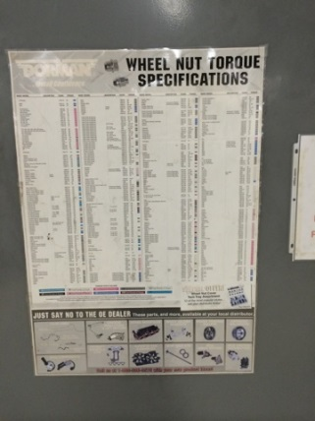
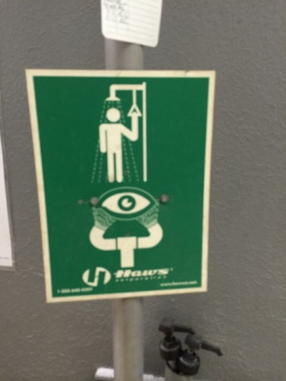
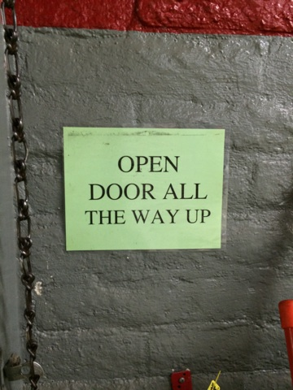
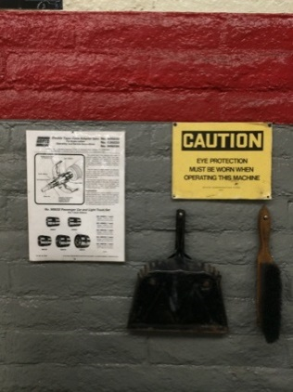
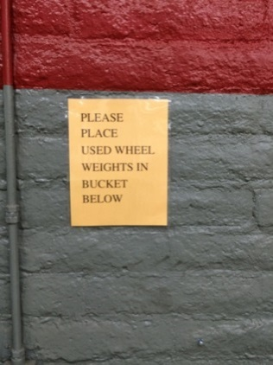
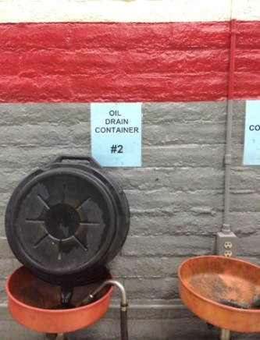
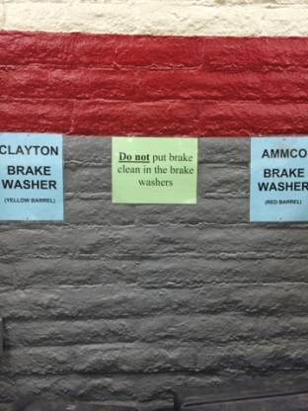
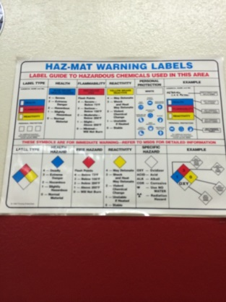
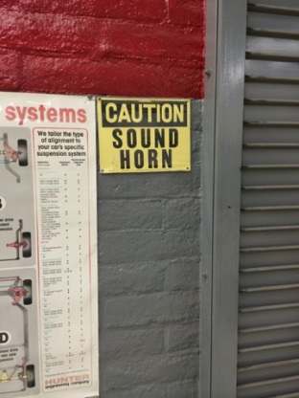
Standard 7.8
Safety Standards
  Safety Test
  http://www.sp2.org/site/
  Course outline
  http://www.mesacc.edu/programs/automotive-performance
  Posters and Signage

Slide 45
Standard 7.9
Personal Standards
  The importance of professionalism, interpersonal skills, care of customers' vehicles and customers' relations are covered in day to day classroom instruction.
  Safety Rules-See Exhibit 7.9A
  Syllabus Safety Signature-See Exhibit 7.9B
  Safety Training and Testing-See Exhibit 7.9C
  Syllabus Integrity-See Exhibit 7.9D

Slide 46
Standard 7.10
Work Habits/Ethics
  Syllabus has attendance policy-See Exhibit 7.10A
  Good work habits and ethics are stressed throughout the training program and integrated into the student’s grade. These include working with others and exhibiting honesty toward customers in dealing with work performed. Live work reinforces what is taught in the classroom and offers a good barometer to the students' habits and ethics.

Slide 47
Standard 7.11
Provision for Individual Differences
  http://www.mesacc.edu/disability-services/faculty/class-accommodations
  No IEP examples available

Slide 48
Standard 7.12
Related Instruction
  MCC offers GTC107 Technical Math Course that is tailored to Automotive, Welding, CAD/CAM/CNC I manufacturing trade skills sets. See catalog-
  http://web.mesacc.edu/schedule/search?class=GTC+++++
  The instructors for this related course are supplied by the discipline for that area and are selected by the discipline’s department chair with input from the program director. The general criteria preferred for that position include a strong understanding of technical student’s needs and characteristics.

Slide 49
Standard 7.13
Testing
  The curriculum provided to the automotive program includes both written tests and hands-on evaluation. Automotive students also take sample ASE tests, random quizzes, a final examination each semester and their lab work is graded. MCC automotive has mandated that every student must pass the course with a score of 70% or better before they can receive certification in that course.
  http://www.mesacc.edu/programs/course-sequences/air-conditioning-ccl
  Sample test- Exhibit 7.13A
  Job Sheets-Exhibit Job Sheets Folder
  Grading Scale-Exhibit 7.13C
  ASE posters, registration material, provisions for testing

Slide 50
Standard 7.14
Evaluation of Instruction
  Each time a course is taught at Mesa CC, the students must evaluate it. This evaluation covers the course content, instructor, and facilities. This information is tabulated and routed through the Vice President of Academic Administration, the Department Chair of the Applied Science and Technologies Department and the instructor. This information is considered important to everyone involved and is used in evaluation of a course and the instructor. The faculty are given the tabulated forms and allowed to keep them for reference. This information includes written comments and is used by faculty members for self-evaluation of the courses they teach. In addition to student evaluation, each tenured faculty is evaluated by the Department Chair of the Applied Science and Technologies Department once every three years; faculty up for tenure are evaluated once every fall for the first six semesters. See Exhibit 7.14A & 7.14B
  Residential Faculty Policies and Resources
  http://ctl.mesacc.edu/handbook/faculty-policies-and-practices/residential-faculty-policy-and-resources/
  In addition, the student follow-up survey form provides a great deal of information that will aid the faculty in the program evaluation. See Exhibit 7.14A
  The Advisory Committee is used to help determine what should be taught but has not been directly involved with how it is taught.
  College Plan
  http://www.mesacc.edu/sites/default/files/pages/section/employees/college-plan-10-13-11.pdf

Slide 51
Standard 7.15
On-Vehicle Service and Repair Work
  Task sheets-Exhibit 7.15A
  Repair orders-Exhibit 7.15B
  Course of study and program policy
  http://www.mesacc.edu/programs/automotive-performance

Slide 52
Standard 7.16
Dual Enrollment
  Currently we are going through process and have adopted to allow dual enrollment for Fall 2015-See Exhibit 7.16A
  Course Offerings for Dual Enrollment
  1. APT 101 Automotive Services-3 credit non-lab class
  2. APT 111 Engine Theory-3 credit non-lab class

Slide 53
Standard 8
EQUIPMENT
Equipment and tools used must be of the type and quality found in the repair industry and must also be the type needed to provide training to meet the program goals and performance objectives.

Slide 54
Standard 8.1
Safety
  All shields, guards, and other safety devices are in place, operable, and used.

Slide 55
Standard 8.2
Quantity and Quality
  Tools and equipment available are industry standard and exist in sufficient numbers to allow for instruction in the areas of certification for which we are applying. See tool inventory for tools available and quantity
  See Exhibit Tool Inventory Folder

Slide 56
Standard 8.3
Consumable Supplies
  The automotive lab has a sufficient quantity of consumable supplies available to students for instruction. This is maintained through an adequate supply budget. This allows us to have an account set up with a local parts stores to provide for unexpected needs as they provide reliable, quick delivery.

Slide 57
Standard 8.4
Preventive Maintenance
  The automotive program director coordinates the equipment maintenance and repair. The required tasks are accomplished by the instructors, student workers, maintenance personnel, or outside repair contractors.
  http://www.mesacc.edu/employees/maintenance-operations

Slide 58
Standard 8.5
Replacement
  The automotive program director is responsible for submitting an up-to-date prioritized list of needed equipment to the Department Chair of the Applied Science and Technologies Department each year. From this list, major purchases are made as funds are available. During the summer all shop tools are inspected and inventoried for damage and necessary replacement. Also supply funds are available during the school year for the purchase of new or specialty tools that may not be on hand.

Slide 59
Standard 8.6
Tool Inventory and Distribution
  Inventory sheets are used to account for the tools and equipment
  Tool sign out sheets-
  See Exhibit 8.6A
  See Exhibit 8.6B

Slide 60
Standard 8.7
Parts Purchasing
  When the need arises for parts, the students are required to list parts on the repair order, have the instructor or shop foreman phone in the order, and price out parts on the work order so they can be paid at the cashier’s office for reimbursement to the store account. Very seldom does this process delay the work. Parts Authority and Carquest stores have provided quick, dependable parts delivery. Many small parts like fuses, lights, motor oil, etc., are kept on hand.

Slide 61
Standard 8.8
Hand Tools
  Each student or lab partners check out a set of hand tools for use during the lab period. This set is comparable to a basic set that is used in industry.
  See Exhibit 8.8A
  See Exhibit 8.8B
  See Exhibit 8.8C
  Students are also encouraged to purchase a personal set of tools while in the program. To aid in the cost of the tools, sales representatives from tool companies are invited to campus to offer tool sets to the students at a auto student purchase price.
  http://www1.snapon.com/SEP
  http://www.matcotools.com/TechEd/

Slide 62
Standard 9
FACILITIES
The physical facilities must be adequate to permit achievement of the program goals and performance objectives.

Slide 63
Standard 9.1
Training Stations
  The main automotive lab with 6000 square feet provides for adequate floor and bench space. In addition to the main lab, two other classrooms/labs are used by the automotive program, seven under canopy parking spots are located outside north of the lab, one with a frame lifting hoist.

Slide 64
Standard 9.2
Safety
  All necessary safety measures have been taken. All appropriate warning signs, fire extinguisher markers, shop safety posters, and safety glasses signs are posted
  The college provides for periodic checks and replacement of fire extinguishers
  An emergency electrical shut-off located conveniently in the center of the shop on the west wall will kill the power to the entire lab
  The lab has an excellent lighting system to provide for safe working conditions
  A set of MSDS sheets plus additional safety information is available in TC-225 Lab.

Slide 65
Standard 9.3
Emergency Maintenance and Repair
  The maintenance staff does a good job of maintaining the facility. They provide all regular maintenance in addition to doing any necessary repairs. They also provide cleaning of the floors each summer. The automotive area is also allowed to employ student workers for 20 hours per week through the school year
  If specific work or maintenance work needs to be done, an automotive faculty member can submit a written work order to the maintenance department.
  http://www.mesacc.edu/employees/maintenance-operations

Slide 66
Standard 9.4
Housekeeping
  Custodial personnel maintains the classroom and helps with the lab facilities
  The automotive shop foreman and faculty takes most of the responsibility for maintaining clean and ordered labs. This is accomplished through student clean-ups at the end of each lab
  Parking and storage areas are also kept clean and neat.

Slide 67
Standard 9.5
Office Space
  Mesa CC provides office space for faculty instructors. The offices are located close to the labs, classroom, and department office
  Each instructor has a telephone, voice mail, and computer with E-mail

Slide 68
Standard 9.6
Instructional Area
  The MCC Auto program has dedicated classrooms (TC218 & TC219) with adequate seating, white board, LCD projector, screen and VCR. We also utilize lab space in TC225 as necessary.

Slide 69
Standard 9.7
Storage
  Locked storage areas are available for all tools, parts, supplies and tool boxes
  An area is available in our fenced-in compound that will accommodate up to 20 vehicles

Slide 70
Standard 9.8
Support Facilities
  The automotive lab has wash-up sinks, soap, and towels available
  Restrooms are located conveniently to lab
  Lockers are available in TC 225 lab on the south doorway.

Slide 71
Standard 9.9
Ventilation
  Auto lab is equipped with operable exhaust gas ventilation systems.
  Classrooms are air conditioned and heated
  Auto lab has 2 electric heaters and is cooled with 4 swamp coolers

Slide 72
Standard 9.10
First Aid
  A first-aid kit is available in the automotive lab TC225 in a marked accessible location. This kit does receive regular inspections for adequate supplies. Mesa Community College also has Health and Safety EMT personnel available with more complete supplies and training to assist in any first aid.
  www.sp2.org
  http://www.mesacc.edu/employees/occupational-health-safety/safety-first-aid/first-aid-basics
  http://www.mesacc.edu/employees/occupational-health-safety/emergency-procedures/render-first-aid

Slide 73
Standard 10
INSTRUCTIONAL STAFF
The instructional staff must have technical competency and meet all state and local requirements for accreditation.

Slide 74
Standard 10.1
Technical Competency
  Jon D’Ambrosio - Program Director & Residential Faculty Instructor
  Bryce Bond - Residential Faculty Instructor
  Steve Skroch - Residential Faculty Instructor
  Jonathan Strait - Adjunct Instructor
  Richard LeBeaumont - Lab Technician
  Douglas Dwyer - Adjunct Instructor
  Steven Julius – Adjunct Lab Assistant
  Russell Suprak - Adjunct Instructor
  John Bentley – Adjunct Lab Assistant
  Daniel Cifalia - Adjunct Instructor
  Robert Jones - Adjunct Instructor

Slide 75
Standard 10.2
Instructional Competency/Certification
  Instructors should meet all state certifying requirements.
  Instructors at the Community College level doesn’t need State Certification. They require at a minimum of 5 years industry experience
  Jon D’Ambrosio – 23 years industry experience, 5 years high school instructor, and 15 years residential faculty at MCC
  Bryce Bond – 16 years industry experience, 10 years high school instructor, and 2 years residential faculty at MCC
  Steve Skroch – 20 years industry experience, 5 years high school instructor, and 3 years faculty at MCC

Slide 76
Standard 10.3
Technical Updating
  20 hours of technical training each year
  Jon D’Ambrosio – See Exhibit 10.3A & 10.3F & 10.3G & 10.3H
  Bryce Bond – See Exhibit 10.3B and 10.3C
  Steve Skroch – See Exhibit 10.3D and 10.3E

Slide 77
Standard 10.4
Substitutes
  An effort is made to schedule classes in such a way that the instructors are available to cover for the other’s classes on a substitute basis. Money is budgeted for substitute pay when it becomes necessary.

Slide 78
Standard 11
WORBASED LEARNING

Slide 79
Standard 11.1
Standards
  N/A.

Slide 80
Standard 11.2
Agreements
  N/A.

Slide 81
Standard 11.3
Supervision
  N/A.

Slide 82
Standard 12
E-LEARNING

Slide 83
Standard 12.1
Access
  Students have access to a computer lab in TC416 as well as the campus library for e-learning.
  http://www.mesacc.edu/library

Slide 84
Standard 12.2
Curriculum and Student Progress
  Students Records
  http://www.mesacc.edu/admissions-records

Slide 85
Standard 12.3
Advisory Committee Input
  NA
  E-learning is available for Mesa Community College students via online academic classes only
  http://www.mesacc.edu/elearning/online-degrees-certificates
  http://www.mesacc.edu/elearning
  http://www.mesacc.edu/schedule/search?online=on

